Slide 1

ECE 281 Lesson 5
Maj Kevin Walchko
1

Slide 2
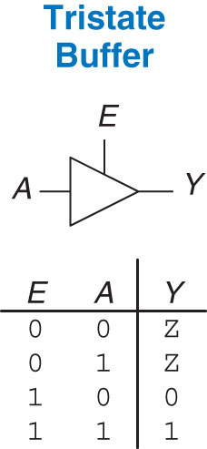
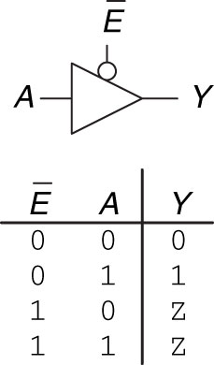
Tristate Buffer – High Impedance (Z)
Figure 2.40 Tristate buffer
Figure 2.41 Tristate buffer with active low enable

Slide 3
Karnaugh Maps (i.e. K-maps)
 | CD
AB |  | 00 |  | 01 |  | 11 |  | 10
 | 00 | 0 |  | 1 |  | 3 |  | 2
 | 01 | 4 |  | 5 |  | 7 |  | 6
 | 11 | 12 |  | 13 |  | 15 |  | 14
 | 10 | 8 |  | 9 |  | 11 |  | 10
Grey Code: 00, 01, 11, 10
 | BC
A |  | 00 |  | 01 |  | 11 |  | 10
 | 0 | 0 |  | 1 |  | 3 |  | 2
 | 1 | 4 |  | 5 |  | 7 |  | 6
Notice they are not in binary order … Grey Code. Only one input can change at a time (i.e. 01 -> 11).

Slide 4
Rules for K-maps - page 78 of book
Use the fewest circles necessary to cover all the 1’s
All the squares in each circle must contain 1’s
Each circle must span a rectangular block that is a power of 2 (i.e. 1, 2, 4, or 8) squares in each direction
Each circle should be as large as possible
A circle may wrap around the edges of the K-map
A 1 in a K-map may be circled multiple times if doing so allows for fewer circles to be used
Circle X’s to make a bigger circle
Not always necessary to circle X’s

Slide 5
Why we use K-maps
K-maps provide an easy visual way to minimize logic
Avoid Boolean Algebra
Recall a Boolean equation is minimized when it is written as a sum of the fewest number of Prime Implicants
Each circle represents an Implicant
The largest possible circle is the Prime Implicant

Slide 6
K-maps
Circle 1’s (groups of 1, 2, 4, or 8)
Only look at what changed
Given the truth table:
A | B | C | F
0 | 0 | 0 | 1
0 | 0 | 1 | 0
0 | 1 | 0 | 1
0 | 1 | 1 | 0
1 | 0 | 0 | 1
1 | 0 | 1 | 1
1 | 1 | 0 | 0
1 | 1 | 1 | 1
Grey Code
 | BC
A |  | 00 |  | 01 |  | 11 |  | 10
 | 0 | 0 |  | 1 |  | 3 |  | 2
 |  | 1 |  | 0 |  | 0 |  | 1
 | 1 | 4 |  | 5 |  | 7 |  | 6
 |  | 1 |  | 1 |  | 1 |  | 0
F(A,B,C) = A’C’+B’C’+AC

Slide 7
K-map Example
You can wrap around all 4 corners
A | B | C | D | F
0 | 0 | 0 | X | 1
0 | 0 | 1 | 0 | 1
0 | 0 | 1 | 1 | X
0 | 1 | 0 | 0 | X
0 | 1 | 0 | 1 | 0
0 | 1 | 1 | X | 0
1 | 0 | 0 | 0 | 1
1 | 0 | 0 | 1 | X
1 | 0 | 1 | X | 1
1 | 1 | 0 | 0 | 0
1 | 1 | 0 | 1 | 1
1 | 1 | 1 | X | 1
 | CD
AB |  | 00 |  | 01 |  | 11 |  | 10
 | 00 | 0 |  | 1 |  | 3 |  | 2
 |  | 1 |  | 1 |  | X |  | 1
 | 01 | 4 |  | 5 |  | 7 |  | 6
 |  | X |  | 0 |  | 0 |  | 0
 | 11 | 12 |  | 13 |  | 15 |  | 14
 |  | 0 |  | 1 |  | 1 |  | 1
 | 10 | 8 |  | 9 |  | 11 |  | 10
 |  | 1 |  | X |  | 1 |  | 1
Note: the X’s (don’t care) makes this table shorter
F = B’D’+A’B’+AC+ABD

Slide 8
K-map Example
F(A, B, C, D) = ∑(1, 2, 3, 5, 7, 10, 11, 12, 13, 14, 15)
A | B | C | D | F
0 | 0 | 0 | 0
0 | 0 | 0 | 1 | 1
0 | 0 | 1 | 0 | 1
0 | 0 | 1 | 1 | 1
0 | 1 | 0 | 0
0 | 1 | 0 | 1 | 1
0 | 1 | 1 | 0
0 | 1 | 1 | 1 | 1
1 | 0 | 0 | 0
1 | 0 | 0 | 1
1 | 0 | 1 | 0 | 1
1 | 0 | 1 | 1 | 1
1 | 1 | 0 | 0 | 1
1 | 1 | 0 | 1 | 1
1 | 1 | 1 | 0 | 1
1 | 1 | 1 | 1 | 1
OR
 | CD
AB |  | 00 |  | 01 |  | 11 |  | 10
 | 00 | 0 |  | 1 |  | 3 |  | 2
 |  |  |  | 1 |  | 1 |  | 1
 | 01 | 4 |  | 5 |  | 7 |  | 6
 |  |  |  | 1 |  | 1
 | 11 | 12 |  | 13 |  | 15 |  | 14
 |  | 1 |  | 1 |  | 1 |  | 1
 | 10 | 8 |  | 9 |  | 11 |  | 10
 |  |  |  |  |  | 1 |  | 1
Note: for clarity, I only put in the 1’s … always do the 0’s too
F = A’D+B’C+AB

Slide 9
You Try
F(D, A, B) = ∑(0, 3, 4, 6, 7)
OR
D | A | B | F
0 | 0 | 0 | 1
0 | 0 | 1
0 | 1 | 0
0 | 1 | 1 | 1
1 | 0 | 0 | 1
1 | 0 | 1
1 | 1 | 0 | 1
1 | 1 | 1 | 1
 | AB
D |  | 00 |  | 01 |  | 11 |  | 10
 | 0 | 0 |  | 1 |  | 3 |  | 2
 |  | 1 |  | 0 |  | 1 |  | 0
 | 1 | 4 |  | 5 |  | 7 |  | 6
 |  | 1 |  | 0 |  | 1 |  | 1
F = A’B’+DB’+AB

Slide 10
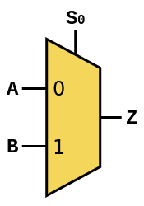
Multiplexer
Multiplexer: 2-to-1 or 2:1 shown below … basically you can switch between different inputs
Example: I have 2 binary sensors (True/False) but only one input pin available to my processor, this allows me to connect to more inputs (this is a silly example at 2:1). 8:1 mux costs me 3 address lines and 1 input pin (4 pins total, but I can read 8 things) … better example.
You can also see this
S | B | A | Z
0 | 0 | 0 | 0
0 | 0 | 1 | 1
0 | 1 | 0 | 0
0 | 1 | 1 | 1
1 | 0 | 0 | 0
1 | 0 | 1 | 0
1 | 1 | 0 | 1
1 | 1 | 1 | 1
 | BA
 | S | 00 |  | 01 |  | 11 |  | 10
 | 0 | 0 |  | 1 |  | 3 |  | 2
 |  | 0 |  | 1 |  | 1 |  | 0
 | 1 | 4 |  | 5 |  | 7 |  | 6
 |  | 0 |  | 0 |  | 1 |  | 1
D₀
D₁
Z = S’A+SB

Slide 11
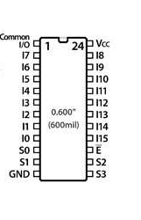
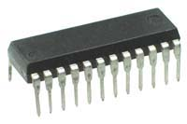
74HC4067 16:1 Multiplexer
output
We will eventually building this chip in software using VHDL
Inputs 0-7
Inputs 8-15
Selection bits
Selection bits

Slide 12
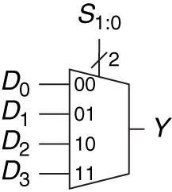
4:1 Mux - VHDL
library IEEE; -- These lines are similar to a #include in C
use IEEE.STD_LOGIC_1164.ALL;
entity mux_4to1 is
Port ( SEL : in STD_LOGIC_VECTOR (1 downto 0);-- select input
D : in STD_LOGIC_VECTOR (3 downto 0); -- inputs
Y : out STD_LOGIC);
end mux_4to1;
architecture Behavioral of mux_4to1 is
begin
-- These statements are called concurrent signal assignments.
-- They all happen at the same time unlike a regular programming language
Y <= D(0) when (SEL = "00") else
D(1) when (SEL = "01") else
D(2) when (SEL = "10") else
D(3) when (SEL = "11") else A(0);
end Behavioral;
CE 2 will start to introduce you to VHDL
Figure 2.57 4:1 multiplexer

Slide 13
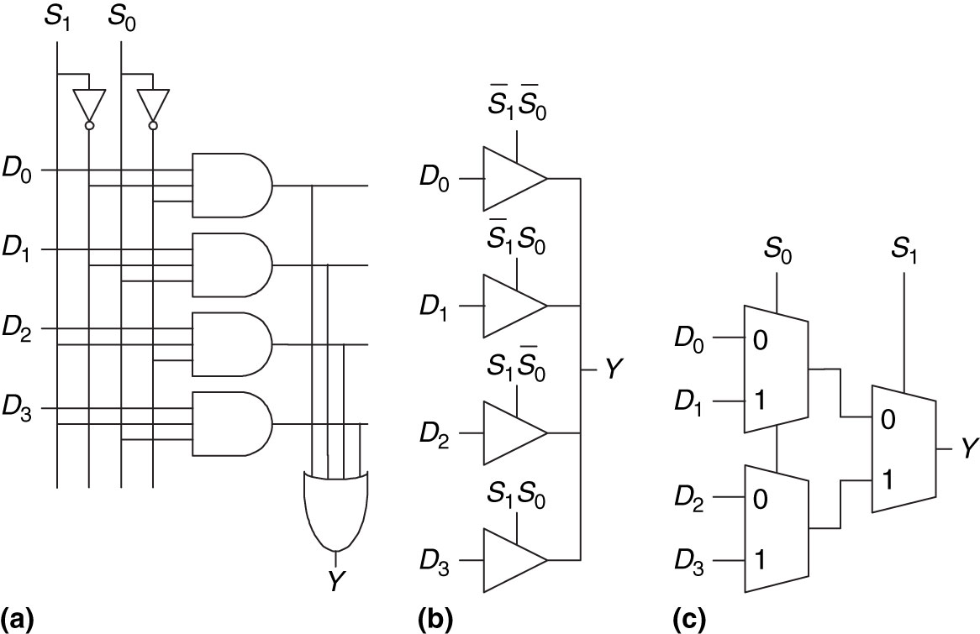
Multiplexers
Figure 2.58 4:1 multiplexer implementations: (a) two-level logic, (b) tristate buffers, (c) hierarchical

Slide 14
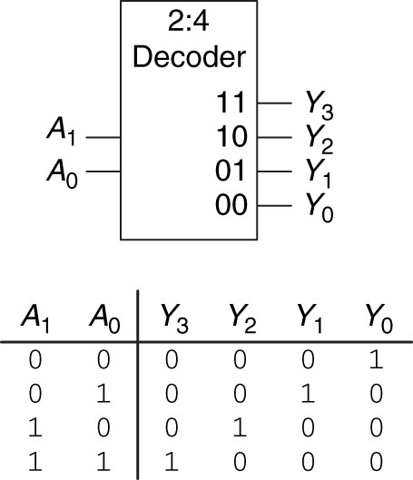
Decoder
Allows you to set an output, here we use 2 pins to set 1 of 4 pins high/True

Slide 15
2:4 Decoder - VHDL
library IEEE;
use IEEE.STD_LOGIC_1164.ALL;
entity decode_2to4 is
Port ( A : in STD_LOGIC_VECTOR (1 downto 0); -- 2-bit input
EN : in STD_LOGIC; -- enable input
Y : out STD_LOGIC_VECTOR (3 downto 0)); -- 4-bit output
end decode_2to4;
architecture Behavioral of decode_2to4 is
begin
Y(0) <= '1' when A = "00" else
'0';
Y(1) <= '1' when A = "01" else
'0';
Y(2) <= '1' when A = "10" else
'0';
Y(3) <= '1' when A = "11" else
'0';
end Behavioral;
Figure 2.63 2:4 decoder

Slide 16

16

Slide 17
Lesson 5 Outline
Time Logs!
MiniQuiz!
Tristate Devices
Karnaugh Maps (i.e. K-maps)
Rules for K-Maps
Multiplexer
Decoders
Homework for Next time:
Look at 2.41 and 2.42

Slide 18
Multiplexers

Slide 19
K-maps
 | CD
AB |  | 00 |  | 01 |  | 11 |  | 10
 | 00 | 0 |  | 1 |  | 3 |  | 2
 | 01 | 4 |  | 5 |  | 7 |  | 6
 | 11 | 12 |  | 13 |  | 15 |  | 14
 | 10 | 8 |  | 9 |  | 11 |  | 10
 | BC
A |  | 00 |  | 01 |  | 11 |  | 10
 | 0 | 0 |  | 1 |  | 3 |  | 2
 | 1 | 4 |  | 5 |  | 7 |  | 6

Slide 20
K-maps
A | B | C | D | F
0 | 0 | 0 | 0
0 | 0 | 0 | 1
0 | 0 | 1 | 0
0 | 0 | 1 | 1
0 | 1 | 0 | 0
0 | 1 | 0 | 1
0 | 1 | 1 | 0
0 | 1 | 1 | 1
1 | 0 | 0 | 0
1 | 0 | 0 | 1
1 | 0 | 1 | 0
1 | 0 | 1 | 1
1 | 1 | 0 | 0
1 | 1 | 0 | 1
1 | 1 | 1 | 0
1 | 1 | 1 | 1
 | CD
AB |  | 00 |  | 01 |  | 11 |  | 10
 | 00 | 0 |  | 1 |  | 3 |  | 2
 | 01 | 4 |  | 5 |  | 7 |  | 6
 | 11 | 12 |  | 13 |  | 15 |  | 14
 | 10 | 8 |  | 9 |  | 11 |  | 10

Slide 21
K-map Example
A | B | C | F
0 | 0 | 0 | 0
0 | 0 | 1 | 1
0 | 1 | 0 | 1
0 | 1 | 1 | 0
1 | 0 | 0 | 0
1 | 0 | 1 | 1
1 | 1 | 0 | 1
1 | 1 | 1 | 1
 |  | 0 |  | 1 |  | 3 |  | 2
 |  | 4 |  | 5 |  | 7 |  | 6

Slide 22
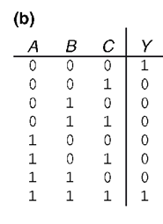

Multiplexers
Implement the following using
An 8:1 mux
A 4:1 mux (plus an inverter for TT)
A 2:1 mux (plus 2 other gates for TT; plus OR and inv for eqn)

Slide 23
K-map Example
A | B | C | D | F
0 | 0 | 0 | X | 1
0 | 0 | 1 | 0 | 1
0 | 0 | 1 | 1 | X
0 | 1 | 0 | 0 | X
0 | 1 | 0 | 1 | 0
0 | 1 | 1 | X | 0
1 | 0 | 0 | 0 | 1
1 | 0 | 0 | 1 | X
1 | 0 | 1 | X | 1
1 | 1 | 0 | 0 | 0
1 | 1 | 0 | 1 | 1
1 | 1 | 1 | X | 1
 | CD
AB |  | 00 |  | 01 |  | 11 |  | 10
 | 00 | 0 |  | 1 |  | 3 |  | 2
 |  | 1 |  | 1 |  | X |  | 1
 | 01 | 4 |  | 5 |  | 7 |  | 6
 |  | X |  | 0 |  | 0 |  | 0
 | 11 | 12 |  | 13 |  | 15 |  | 14
 |  | 0 |  | 1 |  | 1 |  | 1
 | 10 | 8 |  | 9 |  | 11 |  | 10
 |  | 1 |  | X |  | 1 |  | 1
Note: the X’s (don’t care) makes this table shorter
F = B’D’+A’B’+AC+ABD

